Slide 1
Towards a whole new world
LIU SHAOMIN
LU ZHIHAO
MEKALA HOSUR
MICHAEL NG
MING YIFAN

Slide 2
01
Problem Statement
What is the issue with Recommender Systems?

Slide 3

Cold-Start Problem

Slide 4

Proposal:
New and Few

Slide 5
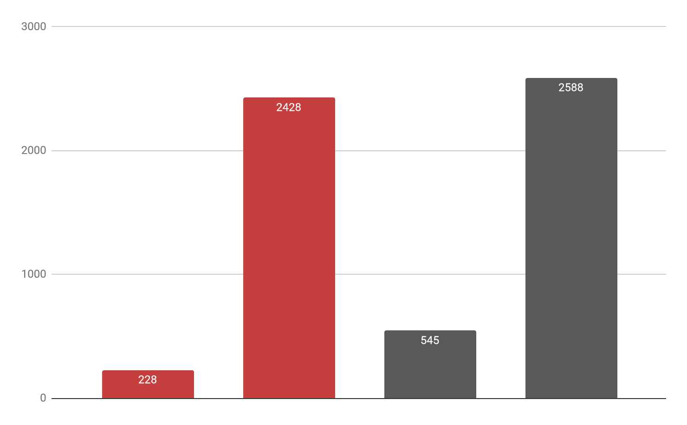
New in 2018
Total 2018
New in 2019
Total 2019
Notes:
Why do we choose to focus on these new customers? That’s because new customers are a rapidly expanding segment in our customer population, consisting of 10% of the population in 2018 to 20% of the population in 2019. They are also an easier group of customers to evaluate the performance of our new recommendation system, as our loyal customers may not be willing to change their purchase behavior without massive discounts. As the supermarket industry runs on thin margins, we might incur a loss instead in trying to retain our loyal customers.

Slide 6
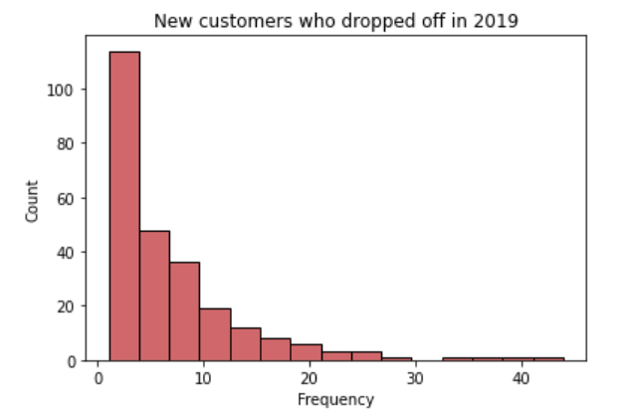
The Drop Off
Some Statistics
New: 545
Churned + New: 254
Losses Incurred: $16,728
Churned + New + Few: 189
Notes:
Distribution - michael
Despite a increase in acquiring new customers, retaining these new customers have proven to be a very difficult task. For the new customers that joined us in 2019, about half of them have dropped off and did not purchase anything in the next year. By summing their average spend, we have incurred a loss of 16,728.
Furthermore, a large proportion of new customers dropped off by their 10th purchase. If we add this constraint, we will have 189 ‘new’ customers with few transactions. Using decision tree techniques, we will be able to optimize our baskets so to retain these new and few customers. Now I’ll pass my time off to Mekala, who will be explaining how these techniques work.

Slide 7

02
Introduction
Inputs and Preprocessing

Slide 8


INPUTS TO THE ENGINE
BASKET SIZE
BASKET ITEMS
1-2 UNIQUE BASKET RECOMMENDATIONS
Regression Tree
One vs Many Multilabel Classification Tree
Customer’s choice!
Notes:
1-2 Unique basket recommendations, Regular personalised basket or a low calorie basket.

Slide 9
PREPROCESSING
One-Hot Encoding
Train-Test splitting!
First Transaction Purchases
Convert categorical variables to Binary Labels
Prevent bias from Loyal Customers’ basket purchases
30% test size + a validation set

Slide 10
03
Regression Tree
Predicting Unique Item Basket Size

Slide 11
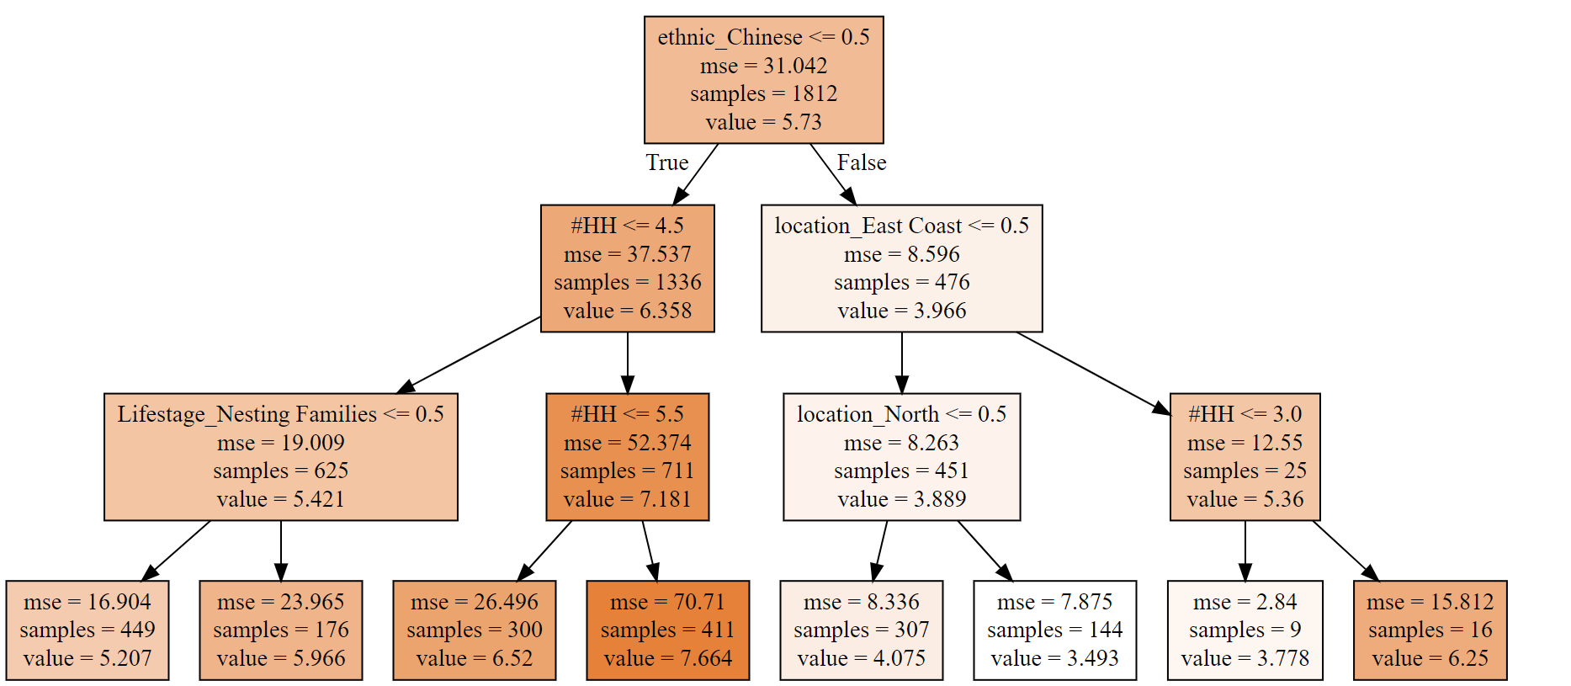
INTERMEDIATE RESULTS
INPUT: Demographic information
OUTPUT:
Number of Unique Categories in an initial Transaction
Notes:
Picture of an intermediate decision regression tree with max_depth 3

Slide 12
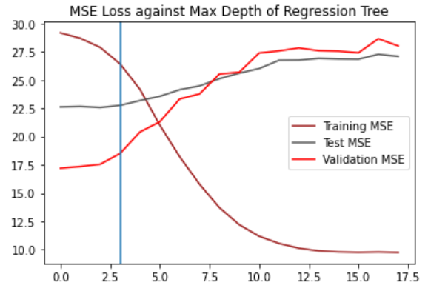


Model Performance
Parameter Tuning Eg.
Random Forest Regressor
Decision Tree Regressor
27.76
35.73 validation loss
Notes:
Need to generate the mse graph
Might want to give a statistic for the max depth
Put in the preliminary mse for decision tree and rfr

Slide 13

BASKET SIZE
* No. of unique categories
Parameter Tuning Eg.
Final MSE value:
22.67
Test Mean-Squared Error Value
Notes:
RMSE final value - Mekala
RMSE or MSE?

Slide 14
04
Classification Tree
Predicting Basket Categories

Slide 15



THE CLASSIFICATION TREE
Model Selection
Tuning Parameters
Random Forest vs
Decision Tree
Max Depth, No. Estimators, Min-Sample Leaf Split
One vs Rest Classifier
62 binary classification problems
Notes:
Anything else to add?

Slide 16

Final F1 micro value:
0.734
Removal of Categories
Category | F1 Score | Support | Result
Cereal Beverage | 0.66 | 534 | Keep
Jam | 0.12 | 266 | Remove

Slide 17
05
Demonstration
How can you use our solution?

Slide 18



PANELISTS’ PROFILE
Alice
John
Small Family unit
Low Cal Basket? No
Low Cal Basket? Yes

Slide 19
06
Results
What do we gain from this?

Slide 20
Potential Gain
Losses Incurred from all New&Few: -$13,300
Proportion of New&Few Customers Retained* | Total Gain
40% | $15,860
33% | $13,086
*Assuming that the customers emulate the same buying behavior the next year.

Slide 21
Thank you!

